Slide 1
Doctor I hurt all over!
Approach to assessment and treatment of pain in the older adult
Dr. Alexandrea Peel

Slide 2
Disclosures
None

Slide 3
Objectives
Develop an framework for assessment of pain in the older adult.
Develop an approach to assessment and treatment of pain in older adults with cognitive impairment.
Develop an approach to treatment of persistent pain in the older adult.

Slide 4

Case 1 Mrs. Johnson in ER
87 yo ♀, frail, presbycusis, widowed
Presents with right shoulder pain, “ difficult historian” due to reduced hearing.
Diagnosed with rotator cuff tendonitis, AUA 6, referred to your team for further assessment
Patient is now in your office and still has ongoing shoulder pain. What is your approach to assessment of pain in this elderly patient?

Slide 5
Approach

Slide 6
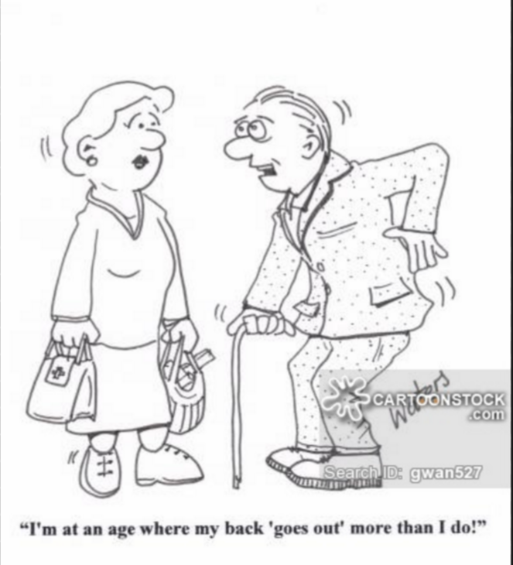
10 Steps to Pain Assessment in Older Adults
Complete history and physical examination, with focus on most pressing pain issues with special focus on screening for evidence of systemic illness
Review of location of pain, intensity, history of fall or trauma, exacerbating and/or alleviating factors, and impact on mood and sleep
A screen for cognitive impairment
A screen for depression and social isolation
A review of the patient’s ADLs (bathing, dressing, toileting, transfers, feeding, and continence) and instrumental ADLs (use of phone, travel, shopping, food preparation, housework, laundry, taking medicine, handling finances)
Assessment of gait and balance
A screen for sensory deficits ( visual/ auditory) that may influence pain perception
Create differential diagnosis
Review completed investigations and decide if further investigations are needed
Create an comprehensive individualized treatment pain

Slide 7
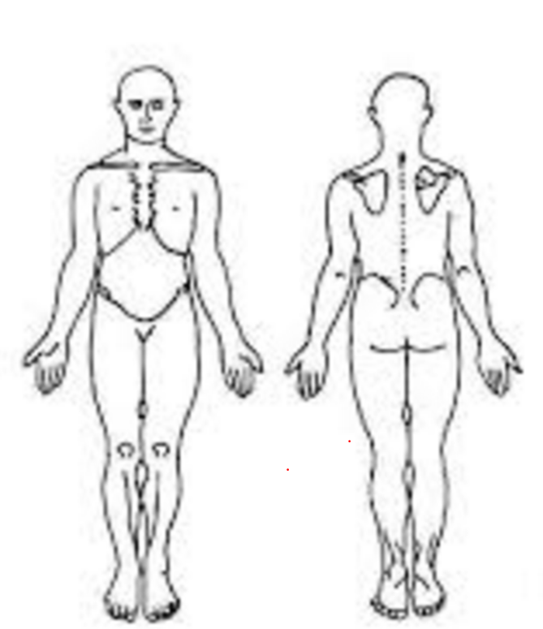
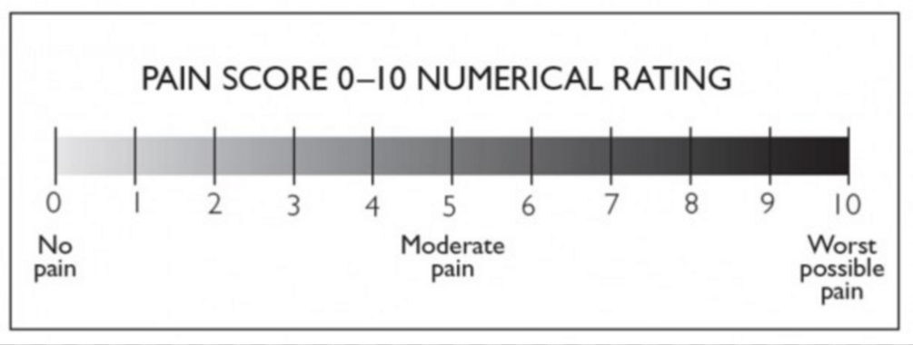
Screening Pearls
Some patients will not report “pain”.
  Try alternate terminology like “ discomfort”, “aches”, “soreness”
To isolate location of pain use a “pain map”
  valid in patients mild dementia
Numerical Rating Scale is recommended to document pain severity at each visit

Slide 8
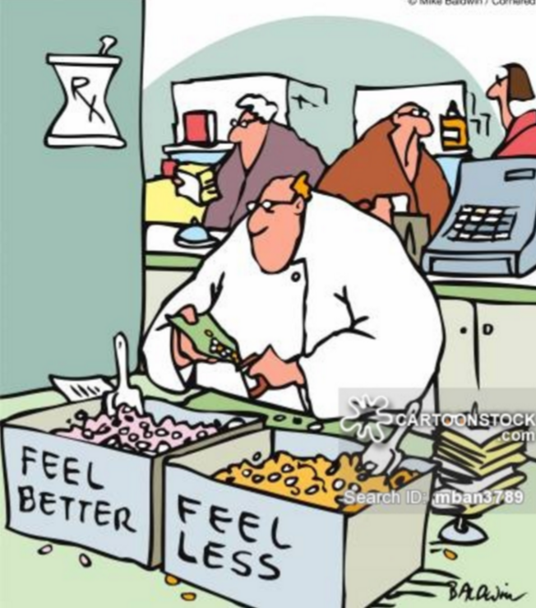
History Pearls
Review treatments tried (NSAIDS, Tylenol, rubs, narcotics, physiotherapy, massage, chiropractor, injections, specialists)
  Why were they stopped ( cost, difficulty with applying creams or swallowing pills, side effects etc.)
Review other medications and associated conditions
Notes:
Pain Management in the Elderly Population: A Review Alan D. Kaye, MD, PhD,* Amir Baluch, MD,{ Jared T. Scott, MD{ *Department of Anesthesiology and Department of Pharmacology, School of Medicine, Louisiana State University Health Sciences Center, New Orleans, LA { Department of Anesthesiology, University of Miami, Miller School of Medicine, Miami, FL { Department of Anesthesiology, Texas Tech Health Sciences Center, School of Medicine, Lubbock, TX
Complete history and physical examination, with focus on most pressing pain issues 2. Review of location of pain, intensity, exacerbating and/or alleviating factors, and impact on mood and sleep 3. A screen for cognitive impairment such as the Folstein minimental examination 4. A screen for depression 5. A review of the patient’s ADLs (bathing, dressing, toileting, transfers, feeding, and continence) and instrumental ADLs (use of phone, travel, shopping, food preparation, housework, laundry, taking medicine, handling finances) 6. Assessment of gait and balance 7. A screen for sensory depression to examine basic visual and auditory function

Slide 9
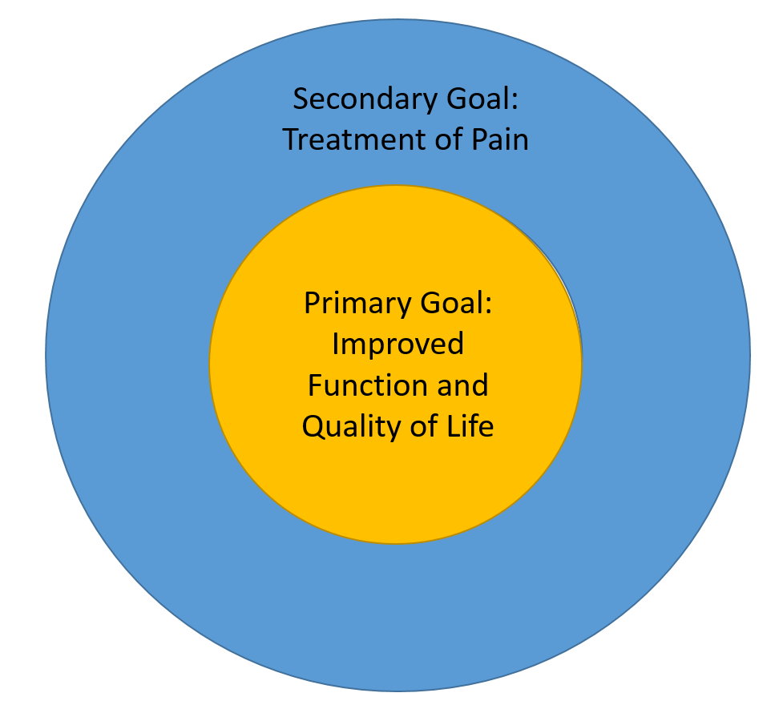
Individualized Treatment Plan
Notes:
Pain makes an older adult vulnerable to other stressors ( difficultly with IADL’s, loss of social support, depression etc). Sometimes targeting the other stressors can be the best treatment target.
Older adult first and person with pain second
The main goal in the treatment of persistent pain is to maximize function and quality of life while minimizing adverse effects that may be associated with treatment. Identifying the impact that the pain has upon all aspects of the patient's life allows the provider to determine treatment targets and evaluate response to treatment in a way that is meaningful to the individual [42].
Due to the multifaceted nature of persistent pain, total pain elimination is not a realistic goal. It is therefore important to ensure that the older patient understands three general principles in the expectations of optimal pain management:
●Persistent pain is multifactorial, requiring an approach that addresses a variety of etiologies and includes both pharmacologic and nonpharmacologic strategies
●Persistent pain is treatable, with improvement anticipated, but it is not curable
●Although pain may not be totally eliminated, substantial improvement in function is realistic [41]
Effective pain management must consider not only the underlying condition(s) contributing to pain, but also patient comorbidities, the increased potential for drug-drug and drug-disease interactions and adverse reactions, and environmental factors: physical, psychosocial, and economic (table 1). General issues with respect to drug prescribing in older adults are discussed in detail separately (see "Drug prescribing for older adults"). Pain management is reviewed below.

Slide 10
Individualized Treatment Plan
Reverse the underlying etiology of pain if possible
Establish goals of treatment with patient/family (not usually cure)
  Optimize Quality of Life
  Minimize adverse effects on function
Consider all patient comorbidities
  Drug-Disease interactions
  Drug- Drug interactions
Start Low, Go Slow
Deprescribe as co-omorbidty changes
Notes:
Pain makes an older adult vulnerable to other stressors ( difficultly with IADL’s, loss of social support, depression etc). Sometimes targeting the other stressors can be the best treatment target.
Older adult first and person with pain second
The main goal in the treatment of persistent pain is to maximize function and quality of life while minimizing adverse effects that may be associated with treatment. Identifying the impact that the pain has upon all aspects of the patient's life allows the provider to determine treatment targets and evaluate response to treatment in a way that is meaningful to the individual [42].
Due to the multifaceted nature of persistent pain, total pain elimination is not a realistic goal. It is therefore important to ensure that the older patient understands three general principles in the expectations of optimal pain management:
●Persistent pain is multifactorial, requiring an approach that addresses a variety of etiologies and includes both pharmacologic and nonpharmacologic strategies
●Persistent pain is treatable, with improvement anticipated, but it is not curable
●Although pain may not be totally eliminated, substantial improvement in function is realistic [41]
Effective pain management must consider not only the underlying condition(s) contributing to pain, but also patient comorbidities, the increased potential for drug-drug and drug-disease interactions and adverse reactions, and environmental factors: physical, psychosocial, and economic (table 1). General issues with respect to drug prescribing in older adults are discussed in detail separately (see "Drug prescribing for older adults"). Pain management is reviewed below.

Slide 11
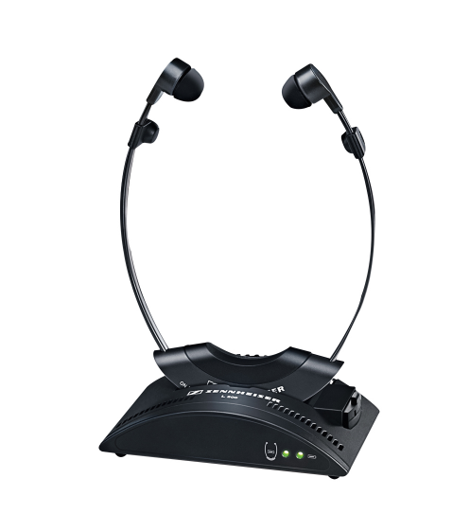
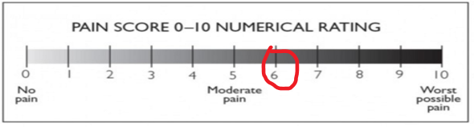
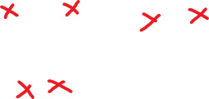
Case 1 Mrs. Johnson
Apply Sennheiser Audioport 200
Optimize hearing
Dull ache/stiffness in both shoulders and hips
Onset over last 3-4 weeks, worse with rest
Stopped cleaning, groceries, getting in/out of tub, going to yoga class going to church in last few weeks as “too fatigued”, feels like her life is over if pain continues, poor appetite
No trauma/falls, has had nights sweats x 5 weeks, and 18 lbs weight loss over last 6 weeks
No swollen joints/skin, no fevers, no headache, jaw claudication, visual disturbance, no rash
Tried Ibuprofen 600mg PO QID x 3 weeks, massage x1 , no effect
PmHx: HTN, Hyperlipidemia
Meds: Atorvastatin 20mg PO OD, Hydrochlorothiazide 25mg PO OD
Notes:
Communication barriers to reporting pain( sensory, motor, cognitive, language)
VITAMIN C
Vascular, infectious, traumatic, autoimmune, metabolic, iatrogenic,neoplastic, congentital
- claudication, infectionous polyarthritis – traumatic – OA in multiple joints, autoimmune PMR seronegative RA, neoplastic- cancer,

Slide 12
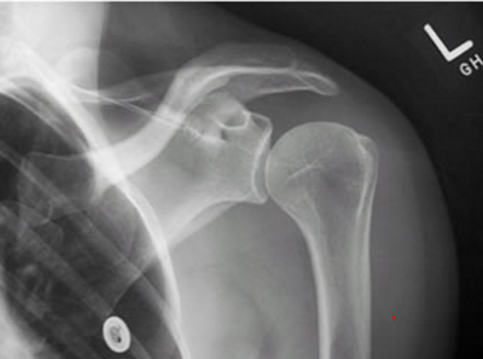
Case 1 Mrs. Johnson
BP lying 110/60, standing 90/64
Pain in to palpation over hip and shoulder muscles, stiffness to ROM, no weakness, or numbness, no synovitis, rheum review of systems negative
Gait is slow, difficulty rising from a chair due to pain/stiffness
MiniCog= N, GCS=3
Completed: CBC: Hb 115 , MCV 86, Plts 300, WBC 8, Cr 120 ( previous 72), BUN 11, K =3.2, Na 135, xray= mild OA, no lytic lesions, no pagets, no visible lung mass
Notes:
Pulses, bruits subcla/femoral, extremity rubor, cyanosis, petechial, ABI in legs, temoral artery tenderness
No rashes, murmurs, purpura
No edema
No signs hypothyroidism – reflex's delayed relaxation, loss hair, goiter, myxedema
No heliotrope rash, shawl sign, gottrons papules
No tremor, ridigity, bradykinesia, or postural instability
http://radiopaedia.org/articles/shoulder-radiograph-an-approach

Slide 13
Case 1 Mrs. Johnson
Differential Diagnosis:
  V- claudication, vasculitis
  I- infectious polyarthritis/arthralgia- bacterial
  ( ex. endocarditis, lyme), viral ( HIV, Hep C, Hep B, Parvo)
  T- traumatic, multifocal MSK disease, fibromyalgia
  A- Polymyalgia rheumatica, seronegative/ seropositive arthritis, RS3PE Syndrome, myositis
  M- osteomalasia, hyperparathyroidism, Paget's disease, hypothyroidism
  I- drug induced myopathy ( statin etc), Parkinsonism with stiffness
  N- myeloma, multiple skeletal metastases
  C- depression
Notes:
(such as fatigue, rash, adenopathy, alopecia, oral and nasal ulcers, pleuritic chest pain, Raynaud phenomenon, or dry eyes and mouth
For example, exposure to or past infection with viral hepatitis may suggest the diagnosis of viral arthralgia. Exposure to ticks or young children may suggest Lyme disease or parvovirus infection, respectively.
Dental work

Slide 14
Case 1 Mrs. Johnson
Additional Investigations: ESR/CRP, CK, Ca, Albumin, VitD, Mg, ALP, TSH, AST, ALT, INR, PTT Bilirubin, Urinalysis and microscopy, radiographs of other shoulder and hips
Notes:
Second Line Investigations: SPEP, UPEP, serum free light chains, RF, ANA ( anti ro, anti La, anti Jo1, Anti RNP, anti Sm), anti CCP, age appropriate malignancy screening, Hep B, Hep C, Parvo virus, Lyme serology

Slide 15
Case 1 Mrs. Johnson
Goals: Tell patient you think there is an underlying cause for pain that could be curable ( vs chronic pain)
Problems/Solutions:
  Cause of Pain: order urgent investigations, consider Prednisone 15 mg PO OD now vs with labs in 24 hours, stop Statin
  Treatment of pain in interm: choose pred ?, Tylenol 1g PO TID, Nursing for heat BID
  Renal Failure: stop Ibuprofen, Repeat Cr 1 week ( if not improved), needs w/u
  Orthostatic Hypotension/HypoK- stop HCTZ
  Unable to do IADLs: consider CCAC nursing + PSW + Meals on wheels+ other caregivers vs. Private Pay Care Service, vs. admission to geriatric assessment and rehab unit, vs. respite care
  Nutrition: hopefully will improve with treatment of underlying condition, needs meals support in mean time+/- ensure
  Mobility/Falls risk: would gait aid be helpful in interim?

Slide 16
Case 1 Mrs. Johnson
Urgent admission to geriatric assessment and rehab unit
Results:
  ESR 100, CRP 35, CK= N, Ca 2.10, Alb 32, Vit D 40, Mg 0.70, ALP= N, TSH = 2.1, AST/ALT/Bili/INR= N, Urinalysis: few hyaline casts, no protein or RBC’s
  X rays : mild hip OA, no lytic or blastic lesions
Diagnosis: Polymyalgia Rheumatica
Plan:
  Started Prednisone 15mg PO OD, faxed rheum referral for follow up
  Completed 4 week rehab stay, gained 10 lbs, returned to independent mobility, CCAC nursing for wellness assessments and dietitian, joined a seniors aquafitness class, organized volunteer transportation, appointed friend as POA, Cr returned to 75
  Completed hearing assessment and ADP funding form for hearing aids
  Started Vitamin D 1000 IU PO OD, and Calcium 500mg PO OD, arranged for bone density testing re: starting bisphosphates , follow blood pressure and steroid induced hyperglycemia
  Advised to avoid NSAIDS in future ( stopped statin, HCTZ)
Notes:
http://www.health.gov.on.ca/en/public/programs/adp/publications/hearaid.aspx

Slide 17
Assessment and Treatment of Pain in Older Adults with Cognitive Impairment

Slide 18
Case 2 Mrs. Swat in Longterm Care
92 yo ♀ advanced dementia, expressive aphasia, vocalizations, dysphagia on puree diet, wheelchair bound, smiles and laughs with music or visits from family, slipped out of wheelchair 6 weeks ago onto ground, no apparent injuries
You are the treating team at the Longterm care facility. The charge nurse asks for you assessment as Mrs. Swat has been striking the nurses lately during care and transfers

Slide 19
Case 2 Mrs. Swat
AGS recommends assessing a combination of facial expressions, verbalizations/vocalizations, body movements, changes in interpersonal interactions, changes in activity patterns/routines, mental status changes to look for evidence of pain
Many tools for screening for pain in nonverbal adults with dementia
  One of the most commonly used is PAINAD Score by Warden et al. 2003
  Scored 0-10, score ˃2 suggests treatment of pain is needed
Notes:
Observe the patient under different conditions
A cut off score of 2 is recommended to intiate pain treatment

Slide 20
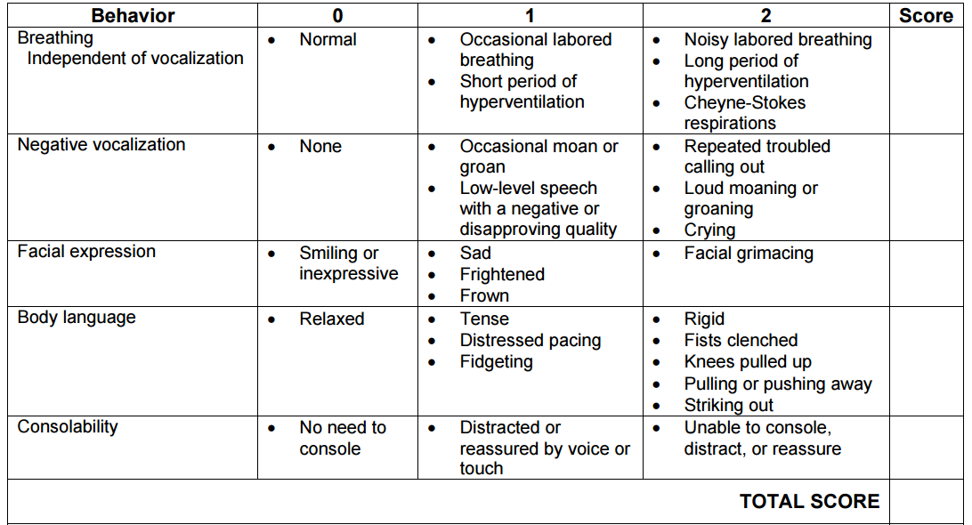
Case 2 Mrs. Swat
Facial expressions
●Verbalizations/vocalizations
●Body movements
●Changes in interpersonal interactions
●Changes in activity patterns/routines
●Mental status changes
Notes:
Observe the patient under different conditions
A cut off score of 2 is recommended to intiate pain treatment

Slide 21
Case 2 Mrs. Swat
Staff and family agree Mrs. Swat seems agitated/ uncomfortable in certain positions, and that this is new
They have not noticed any change in her urine quality ( incontinent at baseline), her BM’s are irregular and firm, her last one was 4 days ago, they check her vitals q2weeks ( so no reported fever, or tachycardia etc), she has had gradual weight loss over the last few years
She has no reported pain medication usage in the MAR
PmHx: chronic renal failure Cr 130, osteoarthritis of knees, MI in 2000 with BM stent
Meds: ASA 81mg PO OD, Atorvastatin 20mg PO OD, Metoprolol 25mg PO BID
Notes:
Pain Management in the Elderly Population: A Review Alan D. Kaye, MD, PhD,* Amir Baluch, MD,{ Jared T. Scott, MD{ *Department of Anesthesiology and Department of Pharmacology, School of Medicine, Louisiana State University Health Sciences Center, New Orleans, LA { Department of Anesthesiology, University of Miami, Miller School of Medicine, Miami, FL { Department of Anesthesiology, Texas Tech Health Sciences Center, School of Medicine, Lubbock, TX
Complete history and physical examination, with focus on most pressing pain issues 2. Review of location of pain, intensity, exacerbating and/or alleviating factors, and impact on mood and sleep 3. A screen for cognitive impairment such as the Folstein minimental examination 4. A screen for depression 5. A review of the patient’s ADLs (bathing, dressing, toileting, transfers, feeding, and continence) and instrumental ADLs (use of phone, travel, shopping, food preparation, housework, laundry, taking medicine, handling finances) 6. Assessment of gait and balance 7. A screen for sensory depression to examine basic visual and auditory function

Slide 22
Case 2: Mrs. Swat
Vitals: BP 130/80, P 62, RR 16, Temp 36.1, O2 98% RA
Exam: abdominal distention, slight tenderness, not peritoneal, impacted stool in rectal vault, patient thrash's while turning for rectal, and when moving hips to test ROM, reduced internal rotation of both hips, pulses and ABI normal, no femoral bruits, no focal weakness, hypo/hyperreflexia or tone abnormality
No recent blood work or investigations

Slide 23
Case 2 Mrs. Swat
DDx pain in pelvic area:
  V- chronic mesenteric ischemia, proximal bilateral claudication
  I- Diverticulitis, UTI, pressure sore
  T- hip or pelvis fracture, MSK pathology of hip/pelvis
  A- Polymyalgia rheumatica, myositis
  M- osteomalasia, hyperparathyroidism, Paget's disease, hypothyroidism
  I- drug induced myopathy ( statin etc)
  N- myeloma, multiple skeletal metastases
  C- depression
Notes:
Needs link to BPSD tools
Apply comprehensive approach to behaviors in dementia
Chibnall JT, Tait RC. Pain assessment in cognitively impaired and unimpaired older adults: a comparison of four scales. Pain 2001; 92:173.

Slide 24
Case 2: Mrs. Swat
Additional Investigations: CK, Ca, Albumin, VitD, Mg, ALP, TSH, CBC, Lytes, Cr, BUN, AST, ALT, INR, PTT Bilirubin, Urinalysis and culture , hips and pelvis and lumbar spine- R/o fracture or OA
Notes:
Second Line Investigations: ESR/CRP,SPEP, UPEP, serum free light chains, age appropriate malignancy screening, radiographs of abdo? Constipation vs obstruction if not clear

Slide 25
Case 2: Mrs. Swat
Goals: Advise patient/family/staff that you worry that pain/ constipation is contributing to agitation. You advise that the behaviors may improve with treatment but that the pain may not be fully curable.
Problems/Solutions:
  Constipation: Enema/ disimpaction now, start osmotic laxative BID until regular BM’s, and then once daily, hold for loose stool
  Cause of hip/pelvis pain: order xray bilateral hip, pelvis, lumbar spine, other labs
  Treatment of pain in interim: Tylenol 1g PO TID, heat TID, voltaren massage BID or TID, consider need for additional agents
  Stop Statin
  Ask for BSO team to follow patient closely for multicomponent behavior interventions
Notes:
http://southwest.behaviouralsupportsontario.ca/

Slide 26
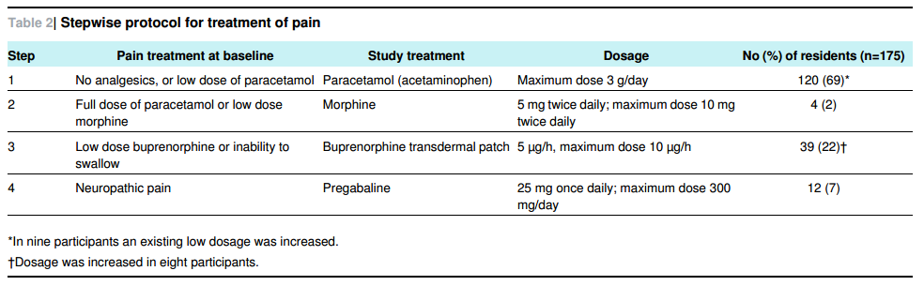
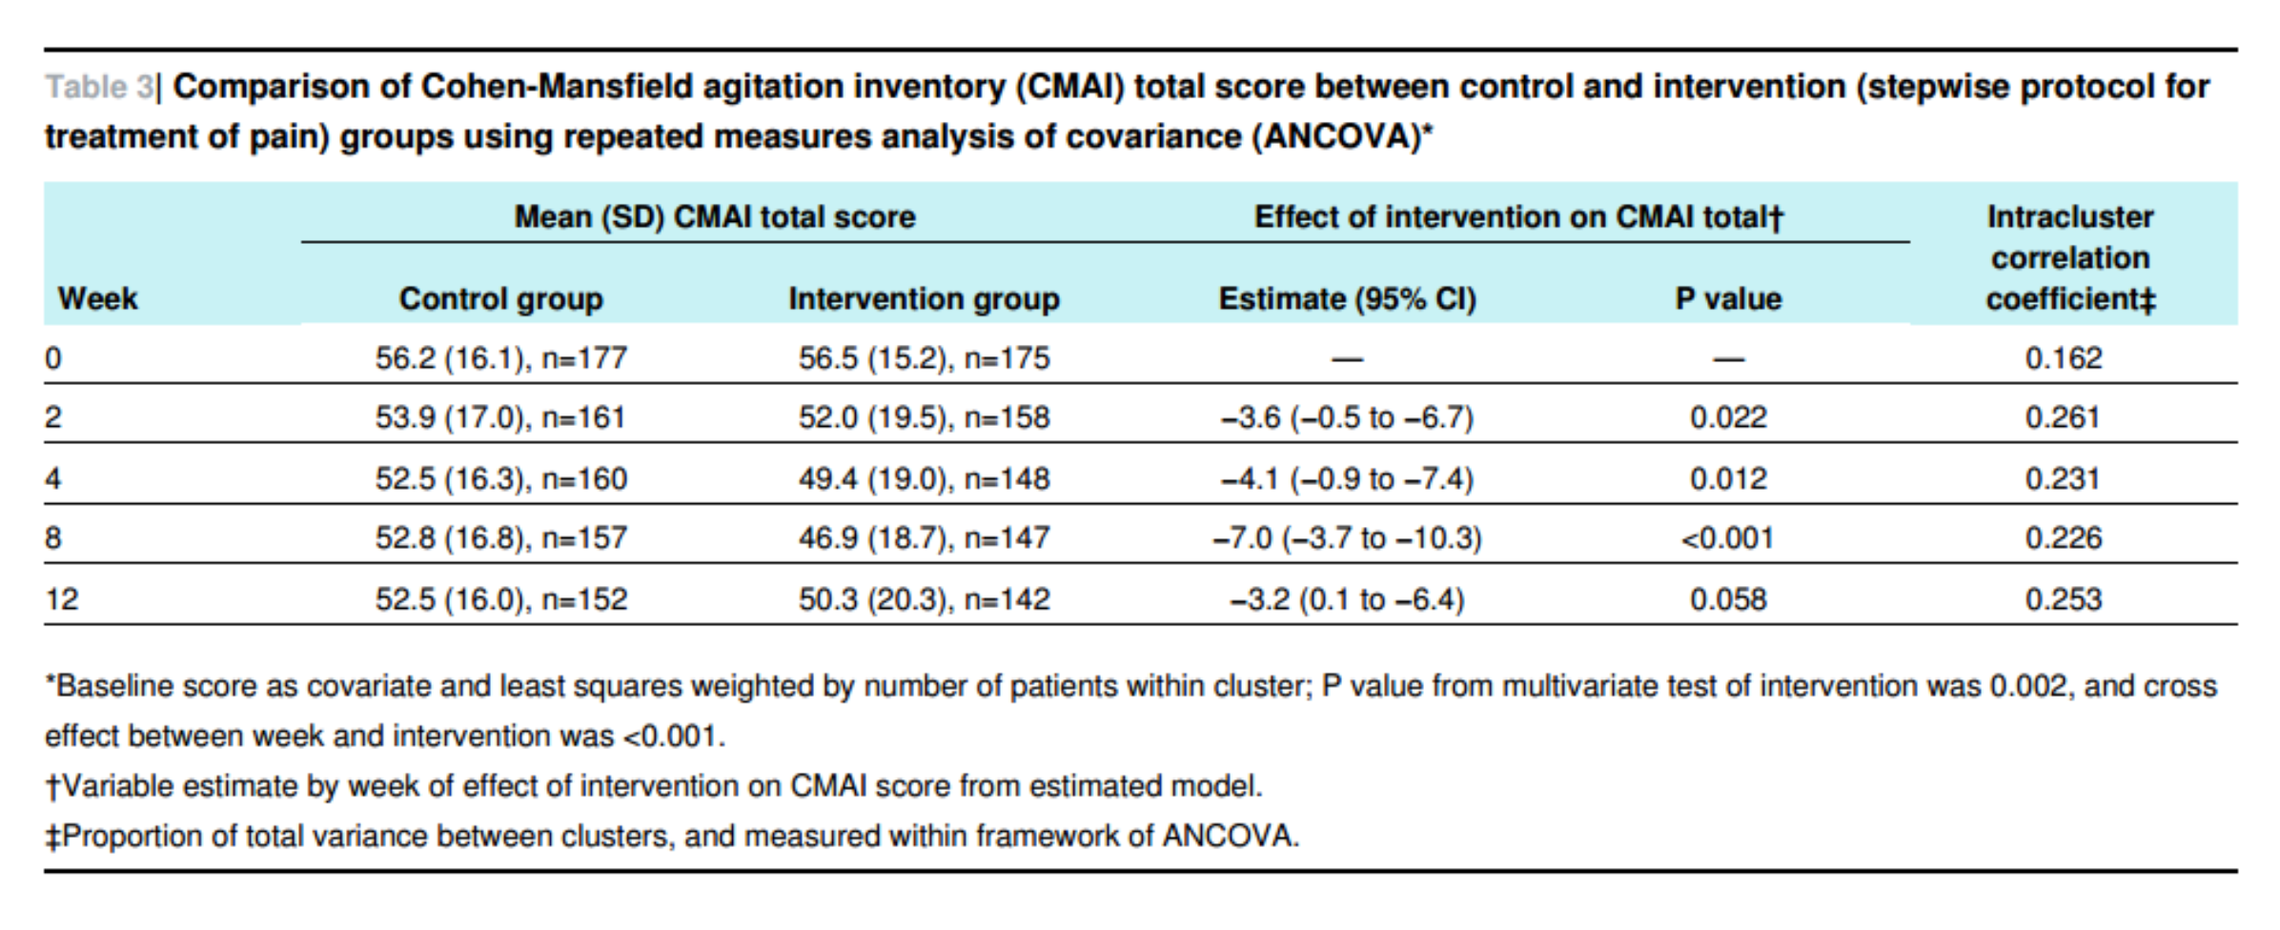
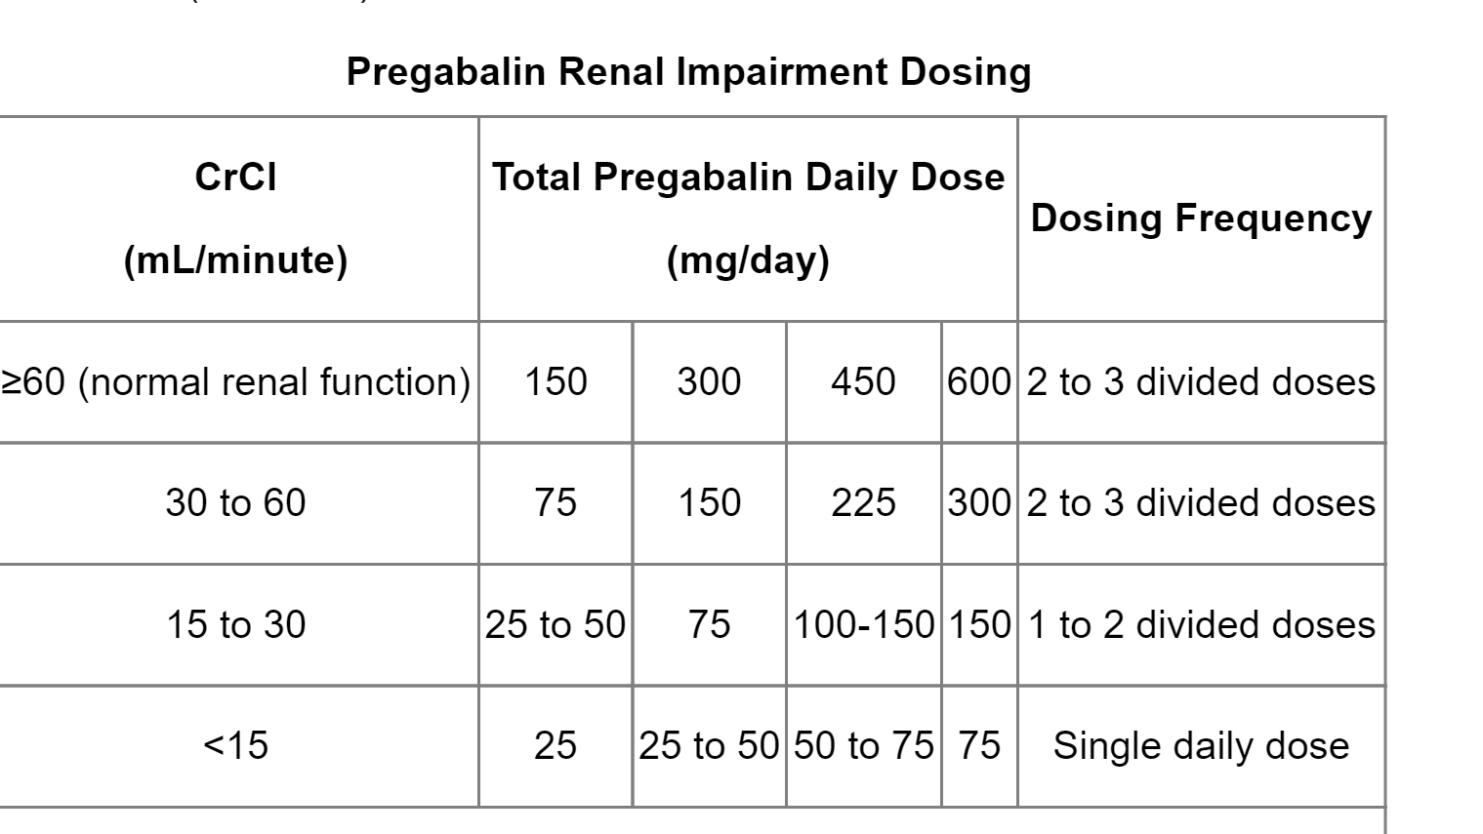
Stepwise treatment of pain to reduce BPSD
RCT in Norway, 352 participants with moderate to severe dementia (MMSE=8) and behaviors, 18 homes, 60 units
Randomized to:
  Stepwise treatment of pain x 8 weeks+ 4 week wash out vs.
  Usual Care
CMAI reduced by 7 Pts in treatment group (CI -3.7 to -10.3, p ˂0.001)
*Equivalent to risperidone
Notes:
AGS 1998 criteria for treatment of pain
25% reduction in cohen Mansfield would be equal to any know treatments for BPSD- multimodal ( risperidone 3%, 13%, 18 % in 3 trials)
Cohen Mansfield over 39 ( significant behavior at least once a week), but NPI agitation less 8 ( severe )
Excluded die next 6 months, severe renal or liver disease
Mean MMSE 7.4 and 8.6 , no difference in ADL after treatment
Transdermal patch: (US labeling) or Adults ≥40 kg (Canadian labeling):
Opioid-naive patients: Initial: 5 mcg/hour applied once every 7 days
Opioid-experienced patients (conversion from other opioids to buprenorphine): Discontinue all other around-the-clock opioid drugs when buprenorphine therapy is initiated. Short-acting analgesics as needed may be continued until analgesia with transdermal buprenorphine is attained. There is a potential for buprenorphine to precipitate withdrawal in patients already receiving opioids.
US labeling:
Patients who were receiving daily dose of <30 mg of oral morphine equivalents: Initial: 5 mcg/hour applied once every 7 days
Patients who were receiving daily dose of 30 to 80 mg of oral morphine equivalents: Taper the current around-the-clock opioid for up to 7 days to ≤30 mg/day of oral morphine or equivalent before initiating therapy. Initial: 10 mcg/hour applied once every 7 days
Patient who were receiving daily dose of >80 mg of oral morphine equivalents: Buprenorphine transdermal patch, even at the maximum dose of 20 mcg/hour applied once every 7 days, may not provide adequate analgesia; consider the use of an alternate analgesic.
Canadian labeling: Patients who were receiving daily dose of ≤80 mg of oral morphine equivalents: Initial: 5 or 10mcg/hour applied once every 7 days

Slide 27
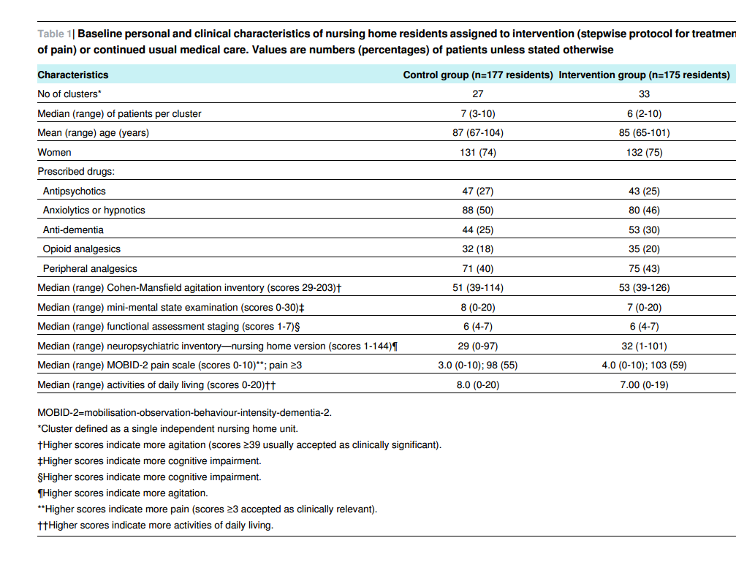

Slide 28
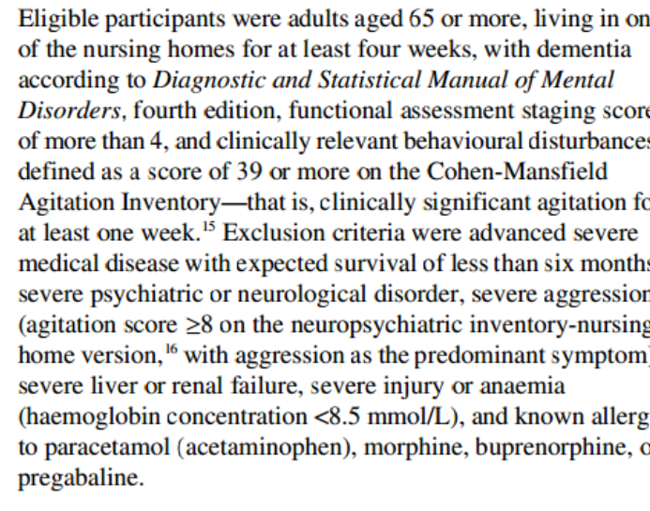

Slide 29
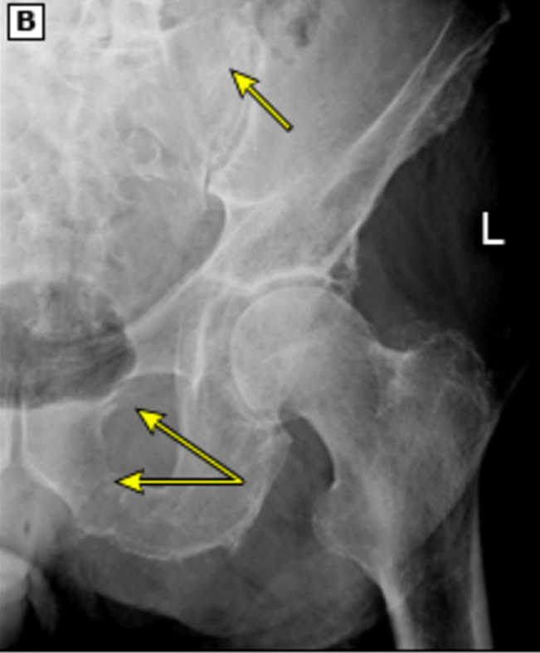
Case 2: Mrs. Swat
Results: CK N, Ca 2.10, Albumin 37, VitD 40, Mg 0.7 ALP N, TSH 1.9, (CBC, Lytes, Cr, BUN, AST, ALT, INR, PTT Bilirubin)- non contributory Urinalysis and culture- neg
Xray pelvis- minimally displaced fractures of sacral ala, superior and inferior public rami

Slide 30
Case 2: Mrs. Swat
Constipation resolved (on chronic lactulose 30ml PO OD)
BSO team started Multicomponent BPSD treatment
Reviewed x ray with orthopedics via telephone consult ( non operative)
Agitation resolved as pain improved
  Tylenol 1g PO TID
  Heat to pelvis TID
  Dilaudid 0.5mg PO 45mins ac am and pm care
Physiotherapy 3x weekly for gradual range of motion
Osteoporosis: elected to start Vitamin D 1000 IU PO OD, Calcium 500mg PO OD, after discussion started patient on risedronate DR 35mg PO weekly
Notes:
Link to osteoposis in LTC guidelines
=

Slide 31
Treatment of Persistent Pain in the Older Adult
Notes:
Persistent pain is defined as pain that continues beyond the expected time of healing, or for at least three to six months
American Geriatrics Society Panel on Pharmacological Management of Persistent Pain in Older Persons. Pharmacological management of persistent pain in older persons. J Am Geriatr Soc 2009; 57:1331.
Persistent pain is the recommended term by AGS due to the negative connotation associated with the term chronic pain

Slide 32

Case 3: Mr. Numbly from home
88 yo ♂ with degenerative disc disease, and herniated disc causing moderate spinal stenosis at L5/S1, AUA =5
Has radiating pains down back of both legs when standing or walking, and chronic ache in his low back
He has spent most of the last 1 month laying either in bed or on the couch, he doesn’t go out ( previously he was able to drive to church and to the restaurant with friends), he has lost appetite, he cannot sleep due to pain, he wishes he would just die, his wife has taken over all IADLS and ADLS- he transfers to the commode to toilet
He has not noticed any numbness, or weakness in legs/sacral region, he has not had any involvement of his bowel or bladder yet

Slide 33
Case 3: Mr. Numbly
PmHx: Chronic Renal Failure Cr 200, and previous depression
Meds: Tylenol 325 mg 2 tab PRN ( using 2x per day), celebrex 100mg PO BID, Percocet 1tab PO TID
+ straight leg raise, pain to ROM and palpation of lumbar spine, reflexs 2+ bilaterally, strength 5/5, normal rectal tone
Patient refuses to walk for gait exam
MiniCog= N, GDS= 11

Slide 34
Individualized Treatment Plan
Notes:
Pain makes an older adult vulnerable to other stressors ( difficultly with IADL’s, loss of social support, depression etc). Sometimes targeting the other stressors can be the best treatment target.
Older adult first and person with pain second
The main goal in the treatment of persistent pain is to maximize function and quality of life while minimizing adverse effects that may be associated with treatment. Identifying the impact that the pain has upon all aspects of the patient's life allows the provider to determine treatment targets and evaluate response to treatment in a way that is meaningful to the individual [42].
Due to the multifaceted nature of persistent pain, total pain elimination is not a realistic goal. It is therefore important to ensure that the older patient understands three general principles in the expectations of optimal pain management:
●Persistent pain is multifactorial, requiring an approach that addresses a variety of etiologies and includes both pharmacologic and nonpharmacologic strategies
●Persistent pain is treatable, with improvement anticipated, but it is not curable
●Although pain may not be totally eliminated, substantial improvement in function is realistic [41]
Effective pain management must consider not only the underlying condition(s) contributing to pain, but also patient comorbidities, the increased potential for drug-drug and drug-disease interactions and adverse reactions, and environmental factors: physical, psychosocial, and economic (table 1). General issues with respect to drug prescribing in older adults are discussed in detail separately (see "Drug prescribing for older adults"). Pain management is reviewed below.

Slide 35

Considerations for Pain Management
Increased
Support
with ADL’s and IADL’s
Nonpharmacological Therapies:
Physical Interventions: physical therapy, acupuncture, chiropractic manipulation, bracing, massage, exercise etc. Psychoeducational interventions: CBT, meditation, patient education
Targeted Therapies:
Joint injection, trigger point injection, topical rubs, surgery in some cases
Nociceptive Pain: Tylenol , or NSAIDS in selected cases
Neuropathic Pain: Antidepressants ( Duloxetine, or Venlafaxine ˃ TCA)
or Anti convulsants ( gabapentin or pregabalin)
Opioids:
Favored Choices: Hydromorphone, Morphine, Oxycodone, Fentanyl, Buprenorphine
Avoided: Meperidine, Codeine, Methadone
Interventions with the least potential risk
Rational Polypharmacy:
2 interventions at moderate dose synergize to afford greater relief while minimizing side effects
Interventions with the greatest potential risk*
*These interventions are still recommended
with appropriate patient selection and careful monitoring

Slide 36
Pearls
Order rubs, and heat therapy BID or TID ( not PRN)
Muscle Relaxants (baclofen, cyclobenzaprine) are avoided due to lack of efficacy and side effects including sedation, dizziness, anticholinergic effects, and weakness

Slide 37
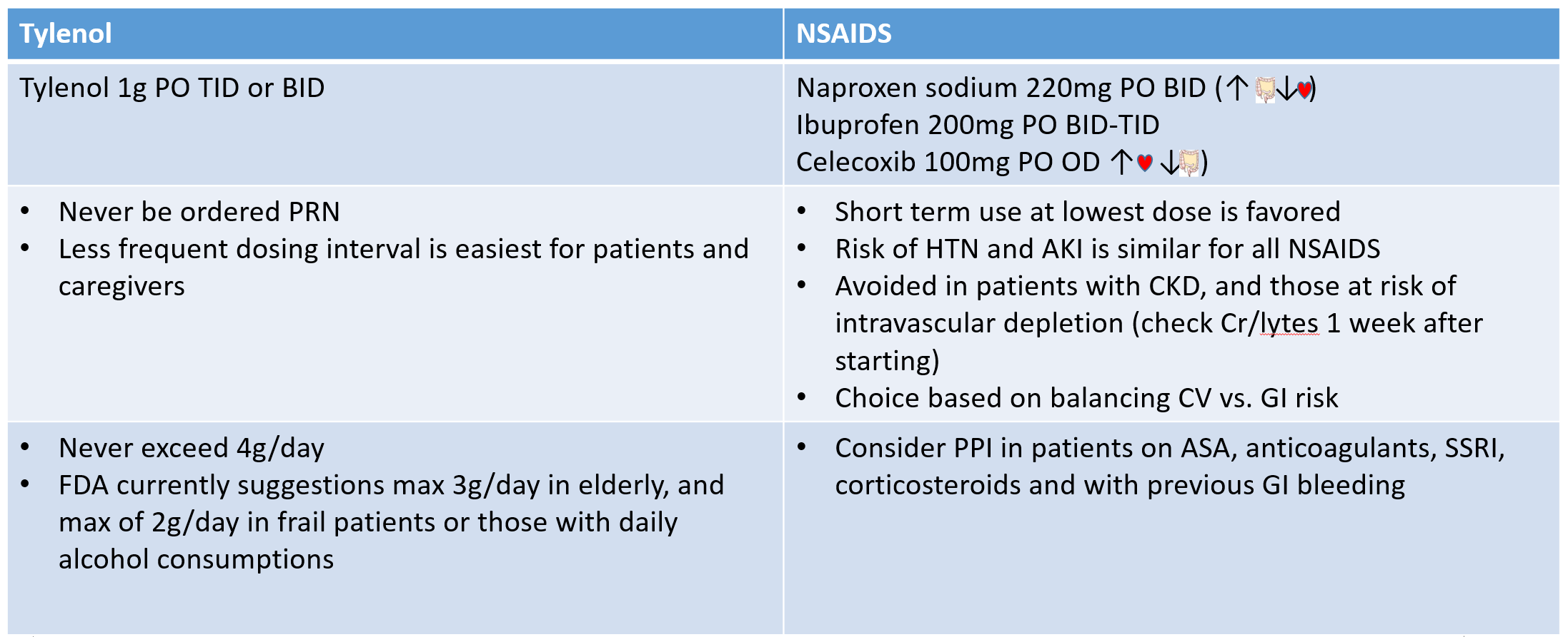
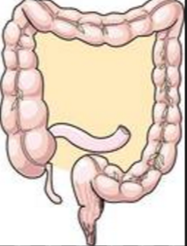
Tylenol and NSAIDS

Slide 38
Neuropathic Pain
Antidepressants | Anticonvulsants
SNRI
Duloxetine 30mg PO OD, increase q2weeks, max of 120mg/day ( 60mg if GFR ≤ 30ml/min) Venlafaxine ER 37.5mg PO OD, increase q2weeks, max 225mg/day ( most frail persons max at 70- 140mg/day) | Gabapentin 100mg PO QHS, gradually increased by 100mg qweekly/as tolerated, max 200mg TID if GFR ≤ 30ml/min Pregabalin 25mg PO QHS, increased by 25mg qweekly/as tolerated, max 75mg/day if GFR ≤ 30ml/min
TCA
Generally avoided due to intolerable anticholinergic effects, sedation, cognitive dysfunction, and orthostatic hypotension relative to SNRI’s | Sedation and dizziness may limit usefulness in frail older adults Both highly dependant on renal clearance

Slide 39

Opioids
Tramadol (not covered by ODB $0.64/tab)
  Starting: 25mg PO BID, max 200mg/day if GFR ≤ 30ml/min
  sometimes chosen as 1/10th as potent as morphine, but can still cause sedation, nausea, constipation etc
  Renally cleared and has toxic metabolites
Hydromorphone
  Starting: 0.25-0.5mg Po BID ( tab and liquid)
  Inactive metabolites= advantage over morphine
Avoid combination tablets with Tylenol due to problems with over/under dosing Tylenol ( Generally preferred to give Tylenol 1g PO TID + opioid)
Buprenorphine and fentanyl patches are not recommended for opioid naive older adults
Refer to AGS 2009 guidelines for further information on specific agents
Notes:
Start with 2.5 to 10 mg orally every four hours as needed (an oral solution is available for initial low doses; lowest tablet strength available in US is 15 mg)
After 3 to 7 days determine 24-hour dose requirement and convert to extended releaseIn patients with renal impairment, clearance of active and potentially neurotoxic metabolites is decreased
Hydromorphone or fentanyl may be better choices for older adults with renal impairment (CrCl <60 mL/min)
For extended-release forms, some patients may require every eight hour dosing for effective analgesia; a 12- to 24-hour dosing interval is appropriate for most older adults
Oxycodone

Slide 40
Tylenol and NSAIDS
Tylenol | NSAIDS
Tylenol 1g PO TID or BID | Naproxen sodium 220mg PO BID (↑ ↓ ) Ibuprofen 200mg PO BID-TID Celecoxib 100mg PO OD ↑ ↓ )
Never be ordered PRN Less frequent dosing interval is easiest for patients and caregivers | Short term use at lowest dose is favored Risk of HTN and AKI is similar for all NSAIDS Avoided in patients with CKD, and those at risk of intravascular depletion (check Cr/lytes 1 week after starting) Choice based on balancing CV vs. GI risk
Never exceed 4g/day FDA currently suggestions max 3g/day in elderly, and max of 2g/day in frail patients or those with daily alcohol consumptions | Consider PPI in patients on ASA, anticoagulants, SSRI, corticosteroids and with previous GI bleeding

Slide 41
Case 3: Mr. Numbly
Goals: Discuss with patient and family that there is evidence of osteoarthritis that will cause chronic pain. You also explain that herniated discs tend to resolved over weeks/months with multimodal treatment. Thus you expect improvement of pain with time.
Problems/Solutions:
  Multimodal Treatment of nociceptive pain component: recommend physiotherapy and massage therapy, voltaren rub TID, Tylenol 1g PO TID ( not PRN), stop Celebrex ( high dose, and CKD)
  Treatment of neuropathic pain/depression: Duloxetine 30mg PO OD x 1 week, then increase to 60mg PO OD x1week ( max given GFR=31ml/min), consider psychology referral for CBT
  If no improvement referral to St. Josephs Pain clinic for trigger point/facet injection https://www.sjhc.london.on.ca/pain-management/referrals
  Poor Sleep: treating pain/ depression will help. Consider Melatonin 3mg Po QHS
  Unable to do IADLs: consider CCAC nursing + PSW + Meals on wheels+ other caregivers vs. Private Pay Care Service, vs. admission to geriatric assessment and rehab unit, vs. respite care
  Consider 4 pronged cane to assist with mobility
Notes:
Persistent pain is treatable, with improvement anticipated, but it is not curable
●Although pain may not be totally eliminated, substantial improvement in function is realistic

Slide 42

Case 3: Mr. Numbly
Attended day hospital outpatient rehab program 2x week/ 6 weeks and had weekly massage therapy, now ambulating with 4 wheeled walker
Pain scores reduced to 0 at rest, and 4 with walking (more tolerable)
Mood is improved, patient is going to weekly coffee with his friends
He is sleeping well
CCAC 45mins daily for personal care
Plan to reassess in 4 weeks

Slide 43
Take Home Points
A comprehensive approach is needed to assess/treat pain in older adults
Consider diagnosis of/treatment of pain to reduce behaviors in persons with dementia
Treatment plan involves much more than medications ( one must create an individualized plan based on patient comorbidities).
Plan should focus on restoration and optimization of function
Uptodate and AGS provide helpful guidelines for treatment of pain in elderly

Slide 44
Recommended Readings
Galicia-Castillo, M. C., & Weiner, D. K. (2014). Treatment of persistent pain in older adults. Uptodate, 1-31.
American Geriatric Society Panel on Pharmacological management of persistent pain in older persons. (2009). Pharmacological management of persistent pain in older persons . Journal of American Geriatric Society, 1331.

